Slide 1

Spotted Python
Week 5 Tutorial
Scaling Relations
Fitting a linear curve
BPT Diagram

Slide 2
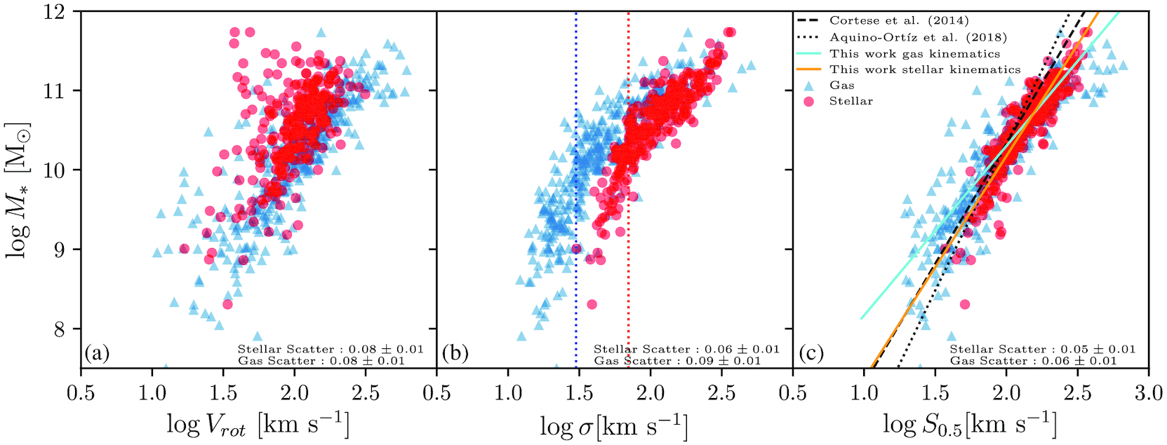

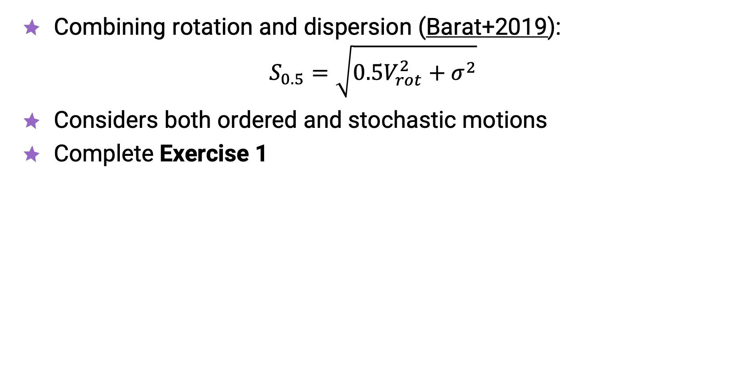
SAMI Scaling Relations
Combining rotation and dispersion (Barat+2019):
$S_{0.5}=\sqrt{0.5V_{rot}^{2}+σ^{2}}$
Considers both ordered and stochastic motions
Complete Exercise 1

Slide 3
Curve Fitting
Many functions allow for curve fitting, e.g.
  scipy.optimize.curve_fit
  scipy.odr
Throughout physics, you will most often need to fit linear and Gaussian functions
Complete Exercise 2

Slide 4
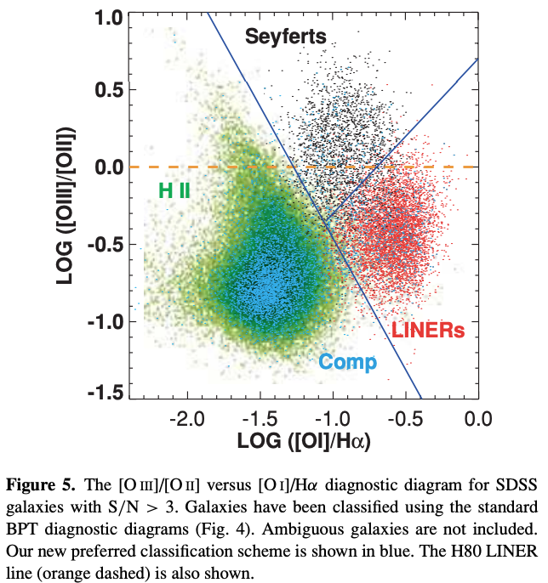
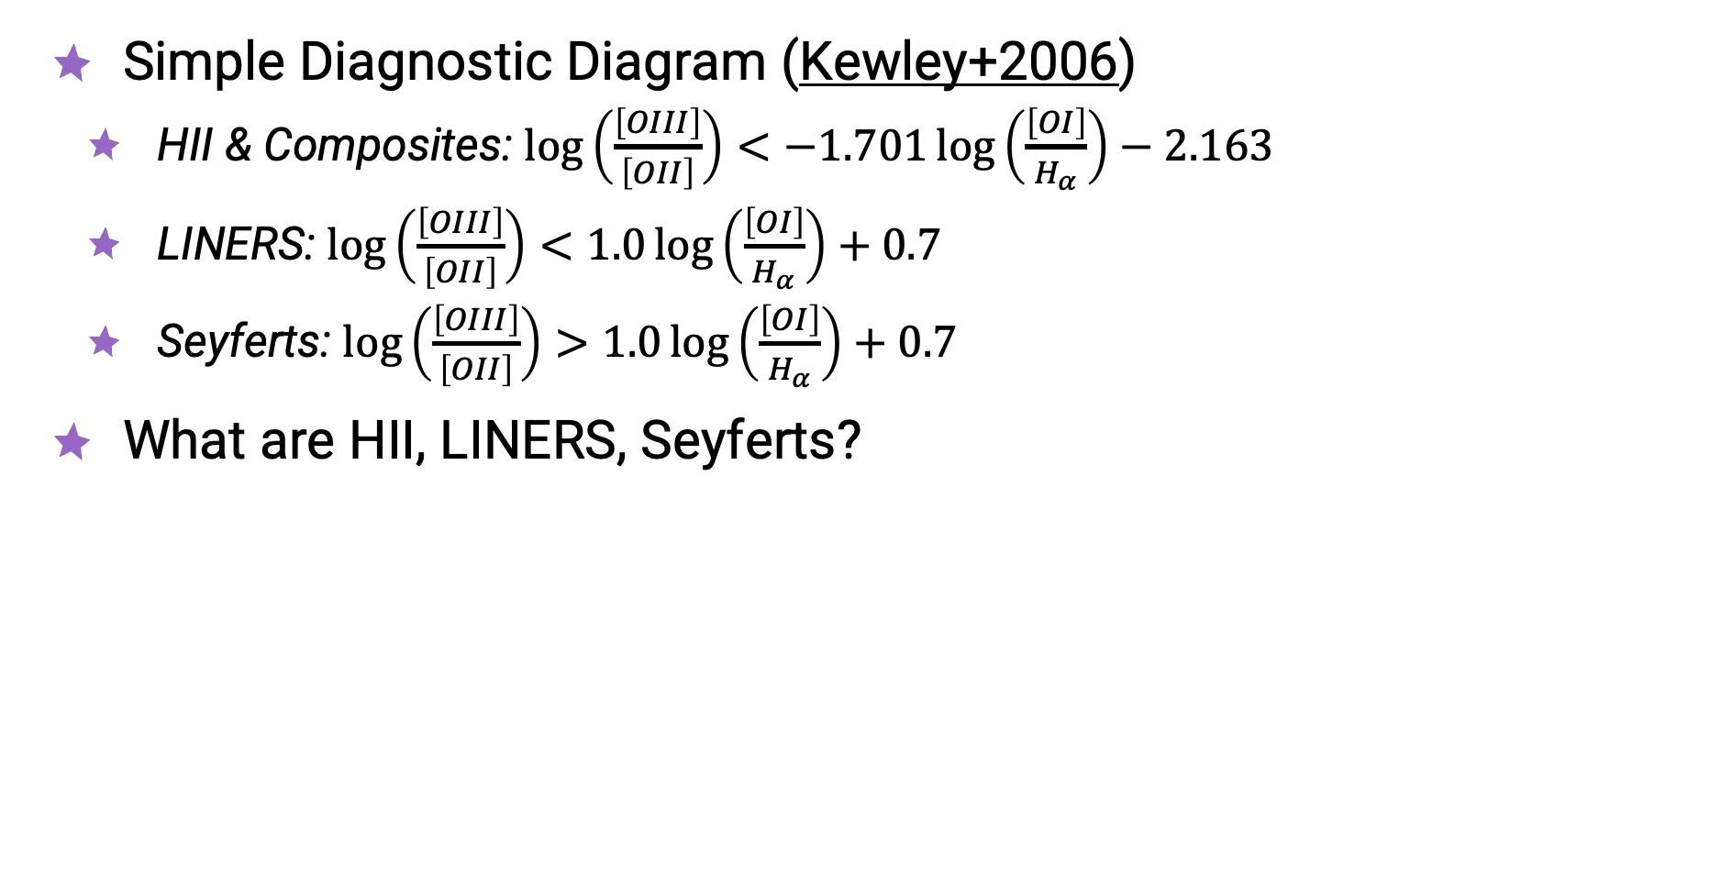
BPT Diagram
Simple Diagnostic Diagram (Kewley+2006)
  HII & Composites: $\log\left(\frac{\left[OIII\right]}{\left[OII\right]}\right)<−1.701\log\left(\frac{\left[OI\right]}{H_{α}}\right)−2.163$
  LINERS: $\log\left(\frac{\left[OIII\right]}{\left[OII\right]}\right)<1.0\log\left(\frac{\left[OI\right]}{H_{α}}\right)+0.7$
  Seyferts: $\log\left(\frac{\left[OIII\right]}{\left[OII\right]}\right)>1.0\log\left(\frac{\left[OI\right]}{H_{α}}\right)+0.7$
What are HII, LINERS, Seyferts?

Slide 5
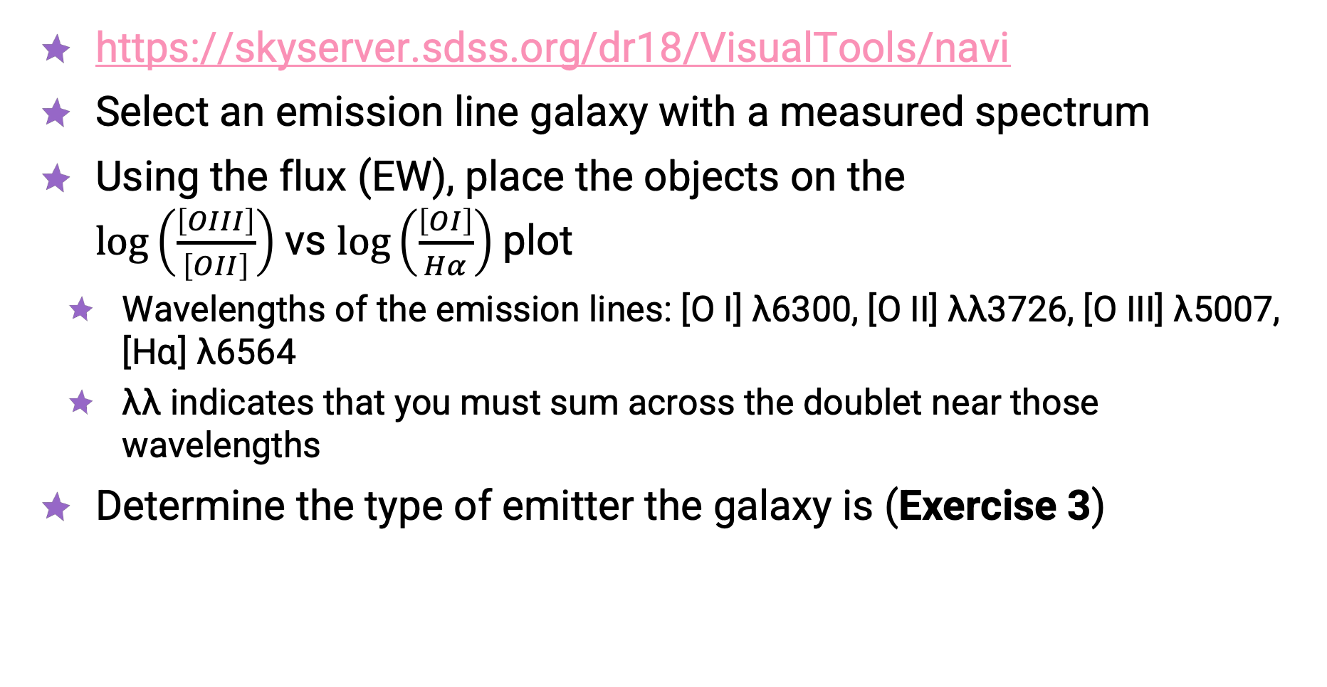
SDSS Navigate Visual Tool
https://skyserver.sdss.org/dr18/VisualTools/navi
Select an emission line galaxy with a measured spectrum
Using the flux (EW), place the objects on the
$\log\left(\frac{\left[OIII\right]}{\left[OII\right]}\right)$vs $\log\left(\frac{\left[OI\right]}{Hα}\right)$plot
  Wavelengths of the emission lines: [O I] λ6300, [O II] λλ3726, [O III] λ5007,
  [Hɑ] λ6564
  λλ indicates that you must sum across the doublet near those wavelengths
Determine the type of emitter the galaxy is (Exercise 3)

